Slide 1
SALES PERFORMANCE DASHBOARD ANALYSIS USING POWER BI
TEAM 3
TEAM NAME : PROFIT DETECTORS

Slide 2
TEAM MEMBERS
SHANTANU ANAND
UDAY KUMAR
TANGUTURI SAI KUMAR
HINDAVI PATIL
MUBASHEER (NOT IN CONTACT)

Slide 3
INTRODUCTION
The Sales Performance Dashboard leverages Power BI to turn complex sales data into actionable insights, providing a comprehensive view of sales and customer trends. This tool is tailored to help decision-makers understand key sales drivers and customer behaviors.
Dataset Overview:
The dataset integrates various data sources, including:
Customer Demographics: Information on customer regions, acquisition dates, and purchase frequency.
Sales Transactions: Detailed records of each sale, including order date, product sold, sale amount, and discount information.
Product Information: Data on product categories, pricing, release dates, and status (e.g., new vs. existing products).
Customer Feedback: Customer ratings and satisfaction metrics, allowing us to correlate sentiment with sales performance.

Slide 4
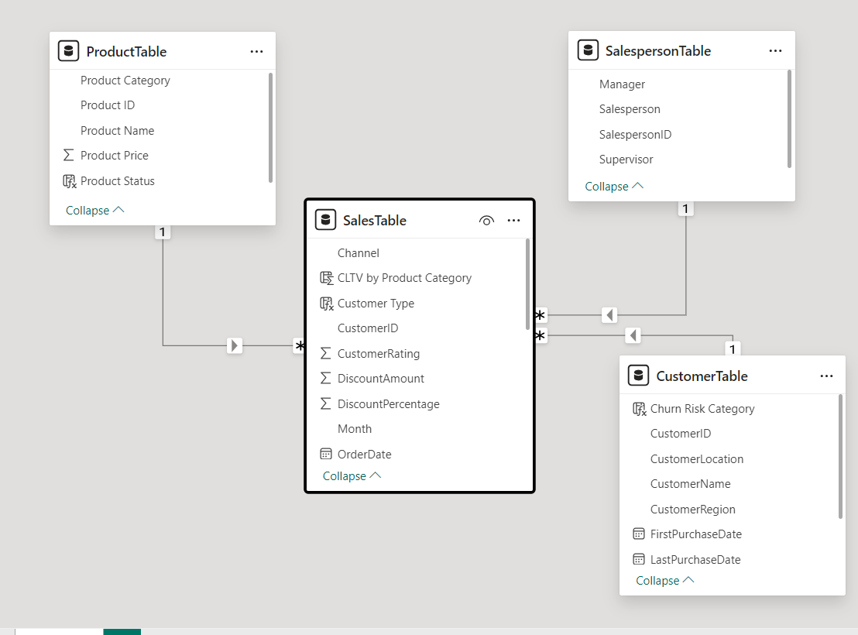
DATASET MODEL VIEW

Slide 5
PROJECT OVERVIEW
Purpose: To create an interactive Sales Performance Dashboard leveraging Power BI for actionable insights.
Key Features:
Integration of datasets: customer demographics, sales transactions, product data, and customer ratings.
Advanced analyses: customer lifetime value, churn prediction, product cannibalization, and customer sentiment.
Data visualization: Charts, maps, and analytics for better decision-making.
Outcome: A dynamic tool for understanding sales trends, customer behavior, and product performance.

Slide 6
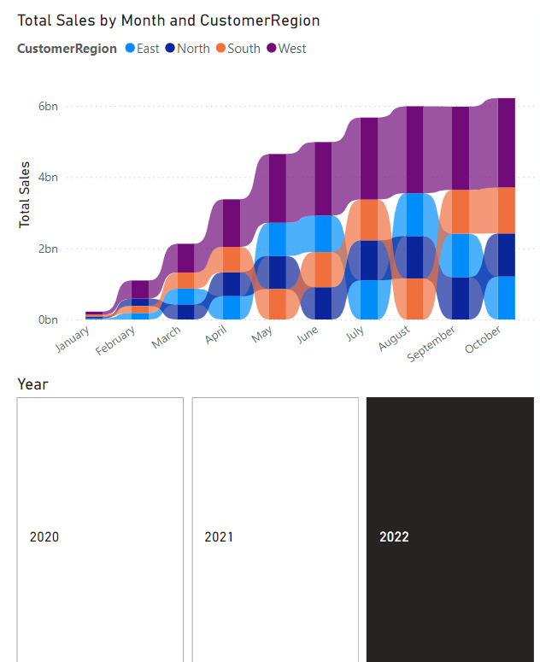
Advanced Total sales analysis
This ribbon chart visualizes total sales by month and customer region, showcasing the rank and contribution of each region over time.
Key Components:
X-Axis (Months):
Represents the months within a selected year (2022 based on the slicer).
Y-Axis (Total Sales):
Indicates the total sales volume.
Ribbons (Regions):
Highlight the rank changes of regions in total sales month over month.
The width of the ribbon represents the contribution of each region's sales relative to others.

Slide 7
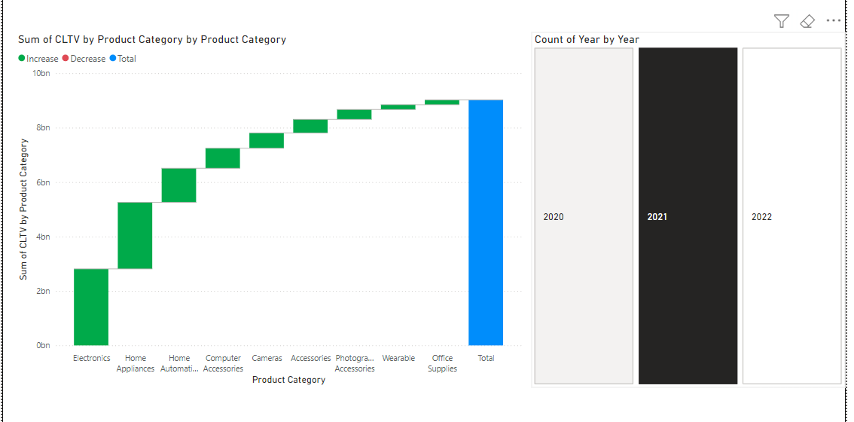
CUSTOMER LIFETIME VALUE
Purpose: This waterfall chart highlights the Customer Lifetime Value (CLTV) contributions from different product categories, providing a cumulative breakdown of value generated.
Each green bar represents the increase in CLTV from a specific product category, such as Electronics, Home Appliances, etc. The blue bar at the end aggregates all contributions to show the total CLTV.
Proposal Part 2 - Customer Lifetime Value (CLTV) Analysis
Key Observations:
Electronics is the highest contributor to the overall CLTV, followed by Home Appliances and Home Automation.
Wearable and Office Supplies contribute the least.
Business Impact:
This helps focus marketing, sales strategies, or resource allocation on categories that yield the highest lifetime value.

Slide 8
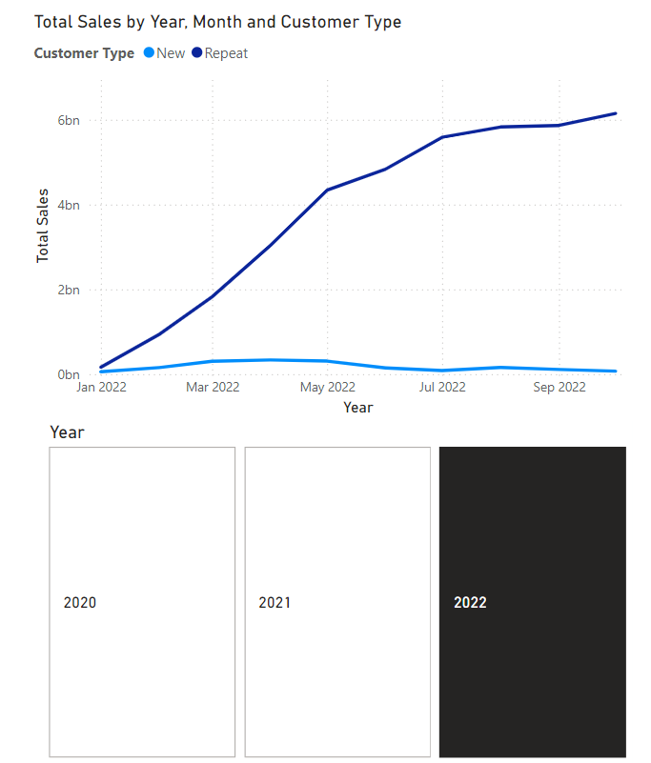
New vs repeated customer analysis for total sales
Line Chart: Tracks monthly sales trends for both customer types over time, highlighting sales performance peaks and customer retention success.
Insights:
Sales Growth:
Repeat Customers contribute significantly to the overall sales growth, peaking in the latter half of the year.
New Customers contribute a smaller share, with minimal growth trends.
Customer Dependency:
The business heavily relies on repeat customers, with limited expansion to new customer acquisition.
Applications:
Retention Strategies:
Prioritize retention strategies for repeat customers, as they drive the majority of revenue.
Acquisition Focus:
Devise campaigns targeting new customer acquisition to balance dependency on existing customers.

Slide 9
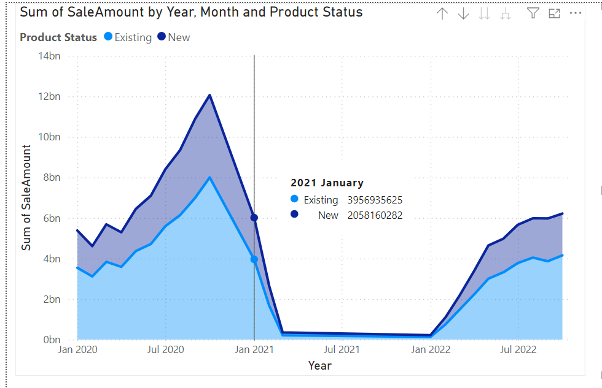
PRODUCT CANABILISM
Objective: Determine if new product launches affect sales of existing products within the same category.
Method: A Stacked Area Chart tracks monthly sales trends for "New" vs. "Existing" products.
Key Insight: If "Existing" product sales decline as "New" product sales increase, this indicates possible cannibalization.
Example: The chart shows fluctuations in sales, particularly during new product introductions, helping assess their impact on existing products.

Slide 10
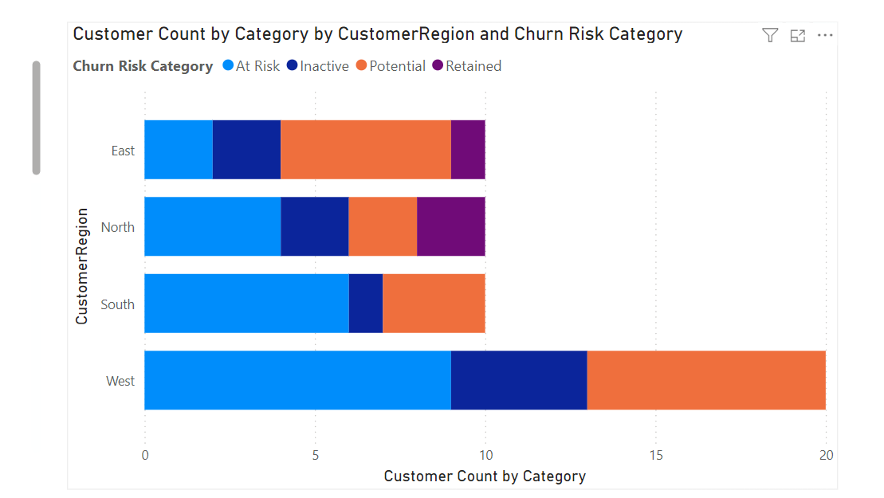
Churn RISK ANALYSIS OF CUSTOMERS
• Objective: Identify customers at risk of churning based on recent purchase frequency and categorize by regions.
• Method: A Stacked Bar Chart categorizes customers by churn risk level (At Risk, Inactive, Potential, Retained) across different regions.
• Key Insight: Regional churn analysis helps to understand areas with higher risk, guiding targeted retention strategies.
• Example: The chart reveals that the West region has the highest number of at-risk customers, prompting potential focus on engagement initiatives in that area.

Slide 11
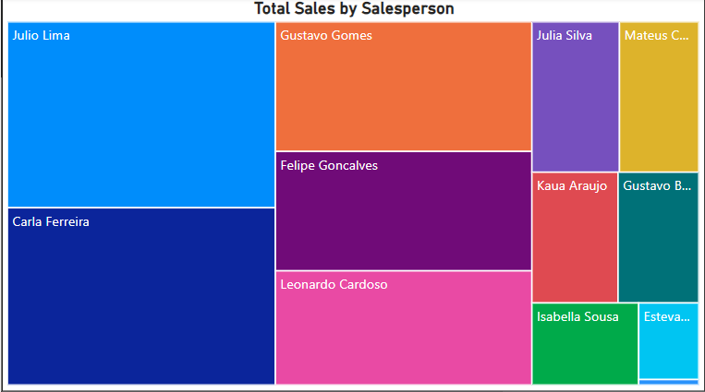
SALES PERSON ANALYSIS – PART 1
Total Sales by Salesperson (Treemap)
Purpose: This treemap shows the proportion of total sales contributed by each salesperson.
Insight: Larger blocks represent salespeople with higher contributions. For example, Julio Lima and Carla Ferreira seem to have significant sales contributions.

Slide 12
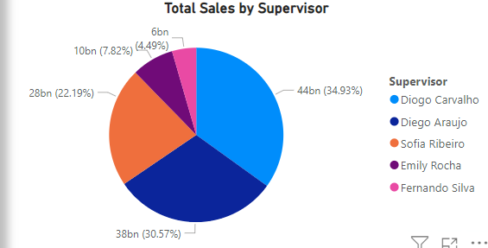
SALES PERSON ANALYSIS – PART 2
. Total Sales by Supervisor (Pie Chart)
Purpose: The pie chart breaks down sales by supervisors, indicating the contribution of sales managed under their teams.
Insight: Diogo Carvalho and Diego Araujo account for a significant portion of the total sales compared to others.

Slide 13
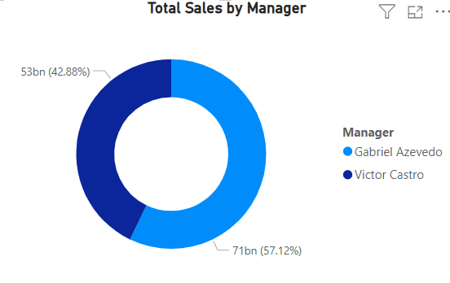
SALES PERSON ANALYSIS – PART 3
Total Sales by Manager (Donut Chart)
Purpose: This chart highlights the distribution of sales between managers.
Insight: Gabriel Azevedo has a larger share (57.12%) of total sales compared to Victor Castro.

Slide 14
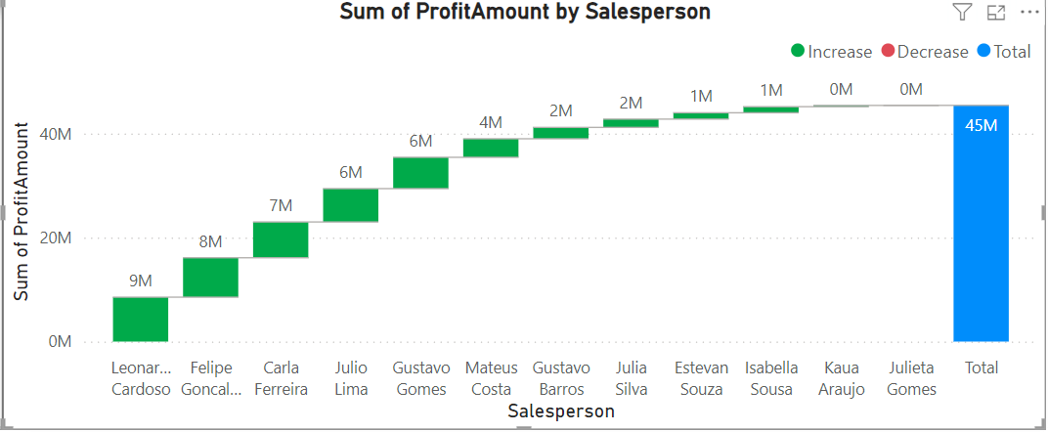
SALES PERSON ANALYSIS – PART 4
Sum of Profit Amount by Salesperson (Waterfall Chart)
Purpose: This chart shows the contribution to total profit by individual salespeople, with increases and decreases clearly visualized.
Insight: The chart highlights that some salespeople, like Leonardo Cardoso and Felipe Goncalves, contributed significantly to profits, while others made smaller contributions.

Slide 15
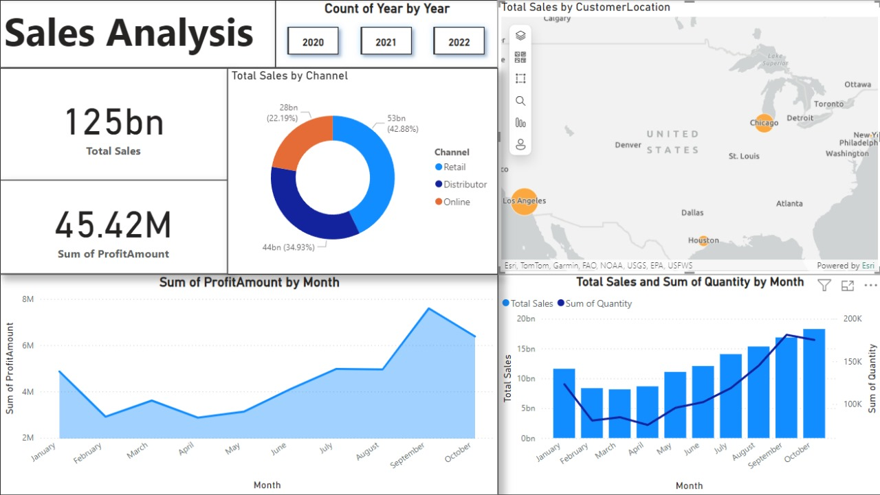
SALES ANALYSIS BASED VISUALIZATIONS

Slide 16
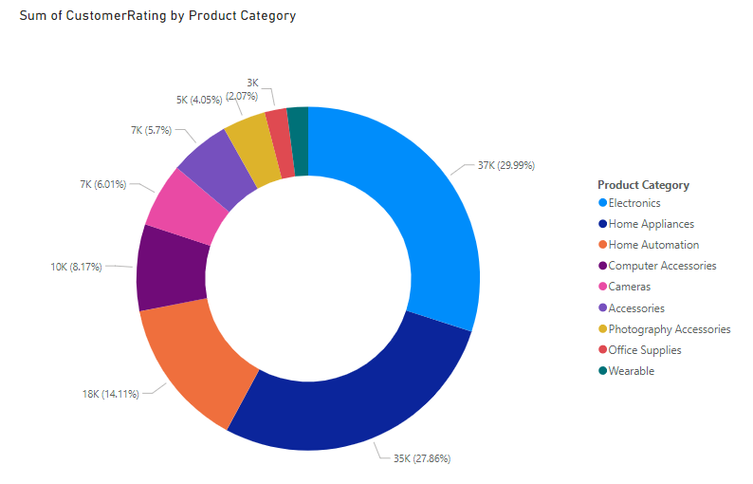
CUSTOMER RATING BASED PRODUCT ANALYSIS
This Donut Chart represents the Sum of Customer Ratings by Product Category, providing a proportional breakdown of customer feedback across various product categories.
Key Insights:
Electronics Dominates: The Electronics category has the highest customer ratings, contributing nearly 30% of the total ratings.
Home Appliances follows with 27.86%, reflecting high interaction or sales in this category.
Computer Accessories and Home Automation also show noticeable shares, indicating these categories perform well among customers.
Customer Preferences: The chart helps identify popular product categories, guiding inventory and marketing strategies.
Target Opportunities: Categories with lower ratings (e.g., Wearable, Office Supplies) may need better marketing, product improvement, or promotional efforts.
Customer Satisfaction: High-rated categories reflect areas of strength, while lower-rated ones may signal improvement opportunities.

Slide 17
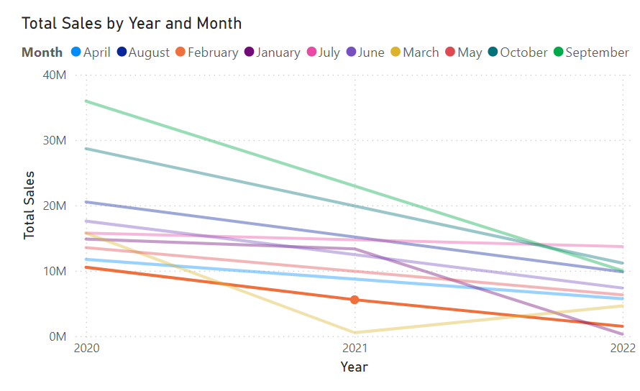
Total Sales ANALYSIS by Year and Month
Line Chart: Total Sales by Year and Month
This chart shows monthly sales trends from 2020 to 2022. It highlights:
Seasonal Peaks: Certain months, like June and July, performed strongly in 2020 but declined sharply by 2022.
Downward Trends: Most months show declining sales over the years.
Consistency: Some months, like February and September, show stable performance.
Insights: Use this chart to identify seasonal patterns, address declining trends, and optimize strategies for high-performing months.

Slide 18
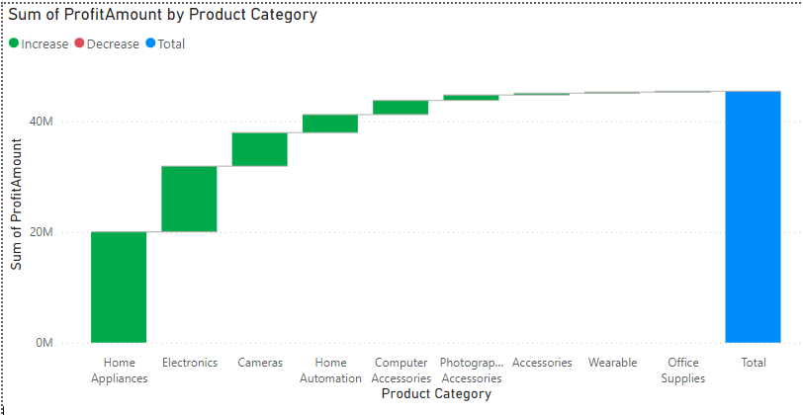
PROFIT ANALYSIS BY PRODUCT CATEGORY
This waterfall chart shows the contribution of each product category to total profit. Here's the breakdown:
Positive Contributors: Categories like Home Appliances, Electronics, and Cameras have made significant positive contributions to overall profit.
Moderate Contributors: Categories like Home Automation, Computer Accessories, and Photography Accessories show smaller, consistent contributions.
Negligible Contribution: Categories like Wearables and Office Supplies have minimal impact.

Slide 19
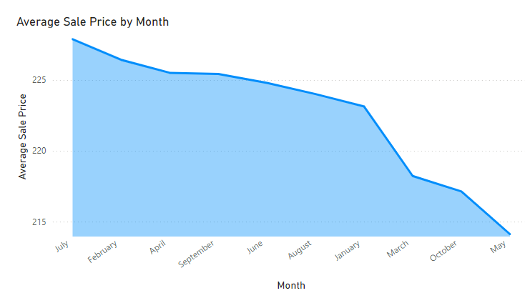
ANALYSIS OF AVERAGE SALE BY MONTH
This chart illustrates the Average Sale Price by Month, showcasing a downward trend over the observed period. The average price starts at a peak in July and steadily declines, reaching its lowest point in May.
Key observations include:
Seasonal Trends: The decline could be linked to seasonality, where higher prices in certain months (e.g., July) coincide with peak demand, while lower prices in others (e.g., May) reflect clearance sales or low demand periods.
Promotions or Discounts: The consistent decline might also indicate the impact of promotional campaigns or strategic price reductions to drive sales volumes.
Market Dynamics: External factors, such as increased competition or shifts in customer preferences, could be contributing to the price decrease.
This visualization is useful for identifying pricing strategies or anomalies and can guide decisions on how to optimize pricing models for improved profitability.

Slide 20
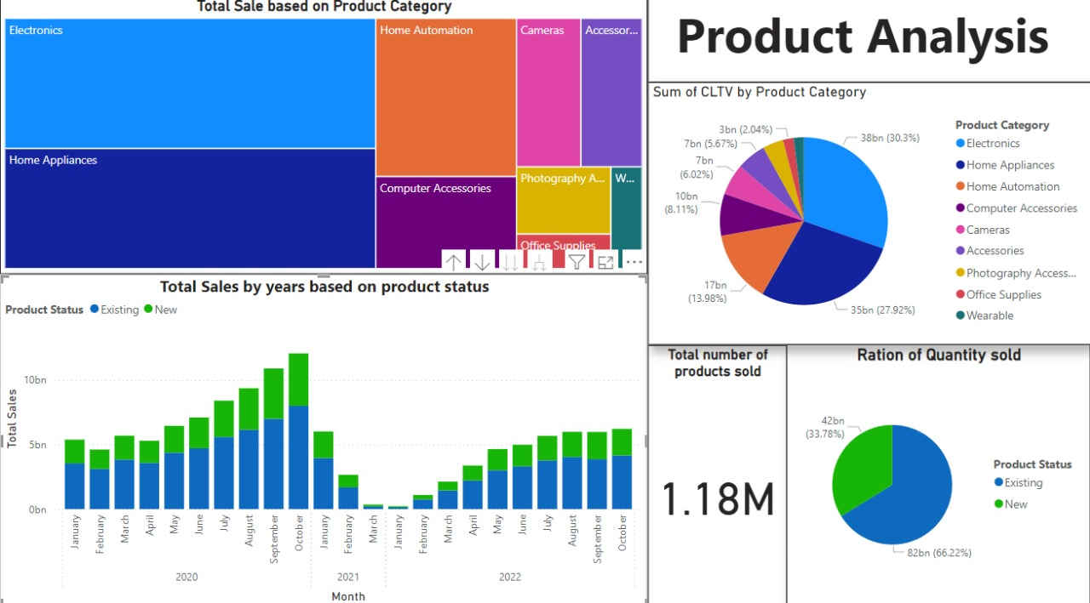
PRODUCT ANALYSIS BASED VISUALIZATIONS

Slide 21
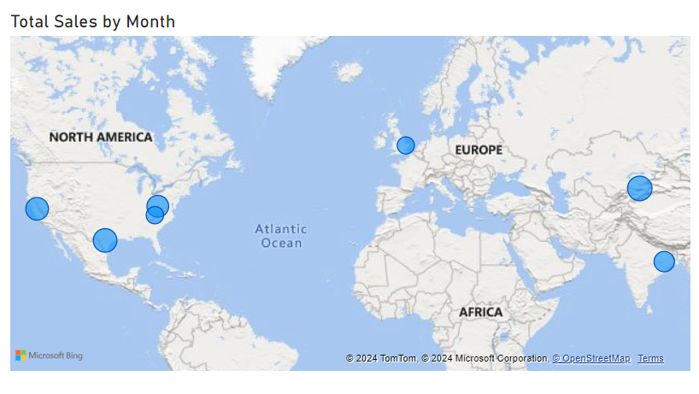
Total sales analysis by region
• Objective: Map sales distribution by customer location to identify regions with high sales potential and growth trends.
• Insights:
Visualizes total sales distribution across different global locations, providing insights into geographic performance.
Helps identify regions with significant sales contributions, enabling targeted marketing strategies.
Reveals areas of opportunity for expansion and regions needing more focus.
• Visualization:
Map Visual: Displays sales volume by geographic location with bubble size representing total sales. Allows users to observe monthly sales patterns across regions.

Slide 22
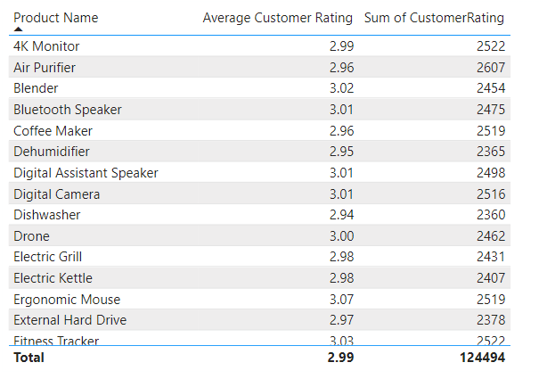
Product sales performan by customer rating
Key Metrics:
Product Name: Lists the individual products.
Average Customer Rating: Reflects the average rating given by customers for each product, providing a direct measure of customer satisfaction.
Sum of Customer Rating: Represents the total cumulative ratings received by each product, indicating the volume of feedback or interactions.
Insights:
High-Rated Products:
Products like Blender (3.02) and Ergonomic Mouse (3.07) show the highest average ratings, reflecting strong customer satisfaction.
These products could be examples of successful quality and performance.

Slide 23
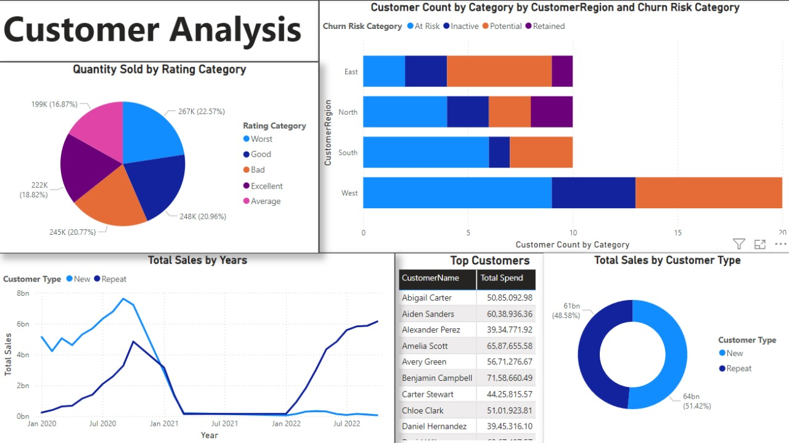
CUSTOMER ANALYSIS BASED VISUALIZATIONS

Slide 24
CONCLUSION
• The Sales Performance Dashboard offers a comprehensive view of sales dynamics, customer behaviors, and product trends.
• Key analyses like CLTV, churn risk, and product sales cannibalization provide actionable insights for business growth and customer retention.
• Advanced visualizations, such as ribbon charts, pie charts, and geo-mapping, ensure data is interpretable and actionable.
• Real-time decision-making is supported, enabling businesses to adapt to challenges and opportunities.
• A modular design ensures future scalability, aligning with evolving business needs.

Slide 25
FUTURE ENHANCEMENTS
Advanced Segmentation: Categorize customers by behavior and demographics for personalized marketing.
Predictive Analytics: Employ machine learning for sales forecasting and inventory optimization.
Marketing Impact Analysis: Assess campaign effectiveness on customer acquisition and retention.
Enhanced Geo-Spatial Insights: Use advanced maps to identify local trends and adjust strategies.
Product Velocity Analysis: Measure product demand trends to optimize production.
Discount Effectiveness Analysis: Evaluate promotion impacts to maximize revenue.
Sentiment Tracking: Integrate customer feedback for better product development.

Slide 26
THANK YOU

